Slide 1
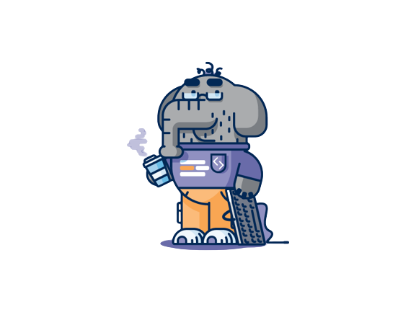
PHP
Looping Statements
Break & Continue
@ Md. Mizanur Rahman

Slide 2

Looping Statements
Loops are used to execute the same block of code again and again, as long as a certain condition is met. The basic idea behind a loop is to automate the repetitive tasks within a program to save the time and effort. PHP supports four different types of loops.
While loop
Do-while loop
For loop
Foreach loop
01

Slide 3
While Loop
The while statement will loops through a block of code as long as the condition specified in the while statement evaluate to true.
<?php
$i = 1;
while($i <= 3)
{
echo "The number is " . $i ."<br>";
$i++;
}
?>
while(condition){
// code to be executed
}
Structure of while loop
02

Slide 4
Do-While Loop
The do...while loop - Loops through a block of code once, and then repeats the loop as long as the specified condition is true.
<?php
$i = 0;
do
{
$i++;
echo "The number is " . $i ."<br>";
} while($i <= 3)
?>
do{
// code to be executed
} while(condition)
Structure of do-while loop
03

Slide 5

While vs Do-While
The while loop differs from the do-while loop in one important way — with a while loop, the condition to be evaluated is tested at the beginning of each loop iteration, so if the conditional expression evaluates to false, the loop will never be executed.
With a do-while loop, on the other hand, the loop will always be executed once, even if the conditional expression is false, because the condition is evaluated at the end of the loop iteration rather than the beginning.
04

Slide 6
For Loop
The for loop repeats a block of code as long as a certain condition is met. It is typically used to execute a block of code for certain number of times.
for(initialization; condition; increment/decrement){
// code to be executed
}
Structure of for loop
The parameters of for loop have following meanings:
initialization — it is used to initialize the counter variables, and evaluated once unconditionally before the first execution of the body of the loop.
05

Slide 7
condition — in the beginning of each iteration, condition is evaluated. If it evaluates to true, the loop continues and the nested statements are executed. If it evaluates to false, the execution of the loop ends.
Increment/decrement — it updates the loop counter with a new value. It is evaluate at the end of each iteration.
The example below defines a loop that starts with $i=1. The loop will continued until $i is less than, or equal to 3. The variable $i will increase by 1 each time the loop runs:
<?php
$i = 0;
for($i=1; $i<=3; $i++)
{
echo "The number is " . $i . "<br>";
}
?>
06

Slide 8
Foreach Loop
The foreach loop is used to iterate over arrays.
<?php
$colors = array("Red", "Green", "Blue");
foreach($colors as $value)
{
echo $value . "<br>";
}
?>
foreach($array as $value){
// Code to be executed
}
Structure of foreach loop
07

Slide 9
There is one more syntax of foreach loop, which is extension of the first.
<?php
$superhero = array(
"name" => "Peter Parker",
"email" => "peterparker@mail.com",
"age" => 18
); // Loop through superhero array
foreach($superhero as $key => $value)
{
echo $key . " : " . $value . "<br>";
}
?>
foreach($array as $key => $value){
// Code to be executed
}
Structure of foreach loop
08

Slide 10
Break statement
PHP break statement breaks the execution of the current for, while, do-while, switch, and for-each loop. If you use break inside inner loop, it breaks the execution of inner loop only.
The break keyword immediately ends the execution of the loop or switch structure. It breaks the current flow of the program at the specified condition and program control resumes at the next statements outside the loop.
<?php for ($x = 0; $x < 10; $x++) { if ($x == 4) { break; } echo "The number is: $x \n"; } ?>
09

Slide 11
THIS IS IT
THANK YOU

